Slide 1
Facade Design Pattern
Debashis Jena
UMGC – SWEN 656 (Fall 2020)

Slide 2
Why Facade Design?
Masks the complexity of the internal components, thus improving the readability and usability of a software library
Creates an interface to a generic functionality, typically with context-specific input validation
Minimizes the impact of changes in the API and simplifies the components that consume the API functionality
Acts as a launching point for a broader refactor of monolithic application in favor of a more loosely coupled code
Avoids repeated code and increases maintainability

Slide 3
Scenarios
Often, the execution of a particular class method requires multiple lines of code or completely a separate class or is complex in nature.
When the same code is repeated multiple times or duplicated in many places across different parts of the application, it degrades the maintainability of the code.
In the Salesforce platform, one of the biggest examples of this is the execution of Web Service callouts.
The generated Apex code typically requires complex code, such as setting HTTP timeout values, setting the target host, as well as setup of the various HTTP request inputs and then parsing of the callout results.

Slide 4
Core Components
Client – Consumer classes, systems or subsystems
Client classes do not access the subsystems or the complicated classes directly but via the façade class.
Facade – The outer interface for the underlying complex functionalities.
Abstract Factory can be used as an alternative to Facade to hide platform-specific classes.
Facade objects are often Singletons because only one Facade object is required.
Its job is to be able to provide to the client more simplified access towards numerous interdependent subsystems that are considered complicated.
To be continued in the next slide …

Slide 5
Façade in Salesforce - Apex
Simplifies the execution of an Apex Web Service Proxy class
Simplifies the execution of custom Apex classes with complex interfaces
Provides a single interface to execute methods in multiple classes (e.g. multiple web service callouts)

Slide 6
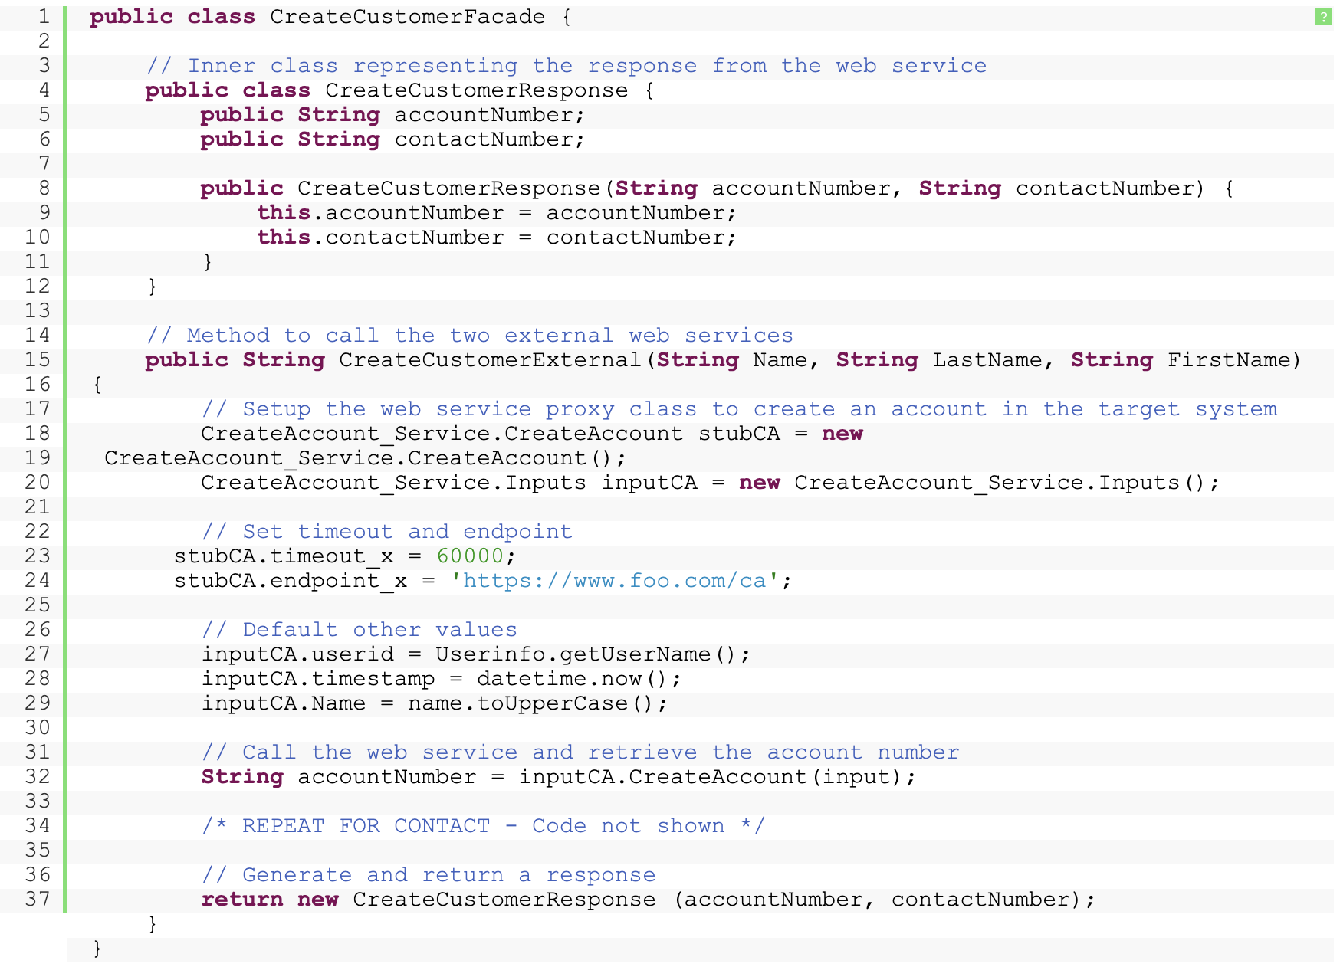
Sample Code
The CreateCustomerExternal method wraps the execution of the two web service calls to create an account and contact in the external system. Repeated code, such as setting timeout values and endpoints, user IDs, timestamps, etc., is encapsulated within this method rather than repeated elsewhere.
The CreateCustomerResponse inner class contains the account and contact numbers generated by the external system.

Slide 7
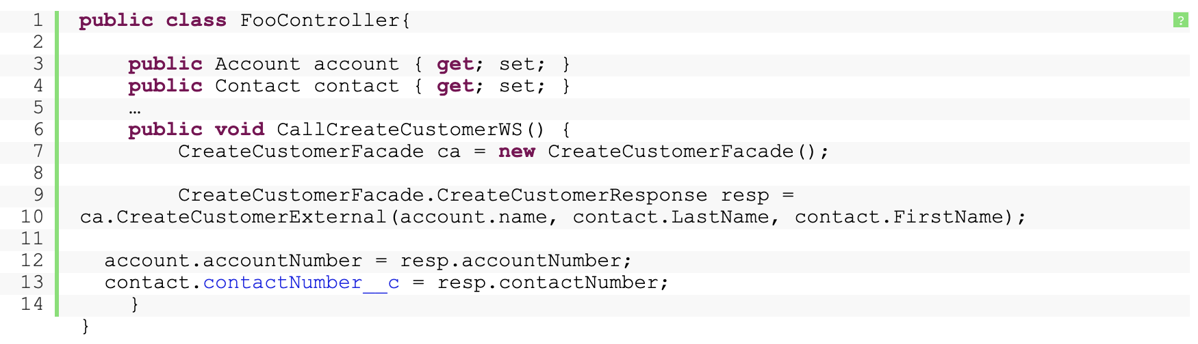
Sample Code (Continued)
FooController is the controller class that calls the façade class CreateCustomerFacade. The façade class internally creates the account and the contact.
FooController can be called by any frontend page, i.e. VisualForce page in Salesforce.

Slide 8
Example
The example here is to create a robot.
The following Java project will set the robot material, color and the body parts.
As each of the actions can be complicated, therefore the façade design is implemented here.
For simple explanation of the code, the implementation will be represented as a few simple System.out.println().

Slide 9
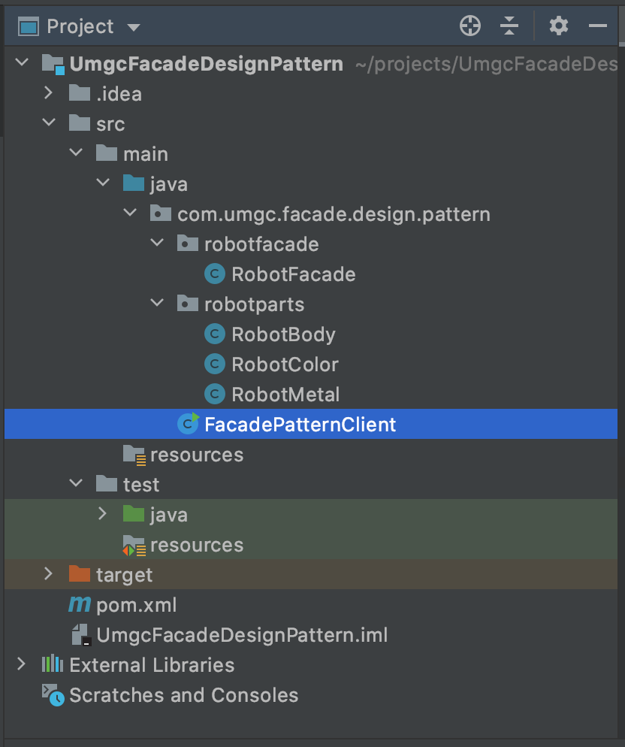
Example – Package Explorer View
robotparts package – Contains each of the subsystem classes that may have the complicated implementations and are classified based on their usage.
robotfacade – Contains the façade class, which has the implementation of the parts classes. This may contain the additional optional façade classes.
The client class can be present anywhere. In this case, it is a main class.

Slide 10
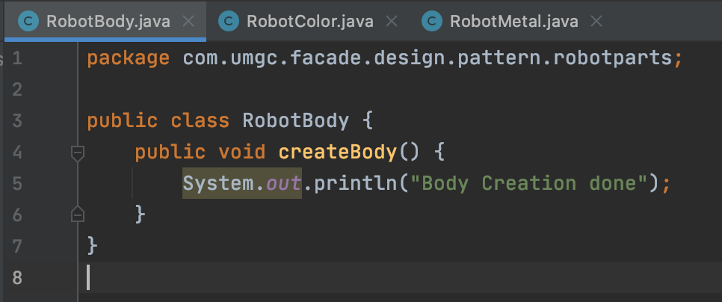
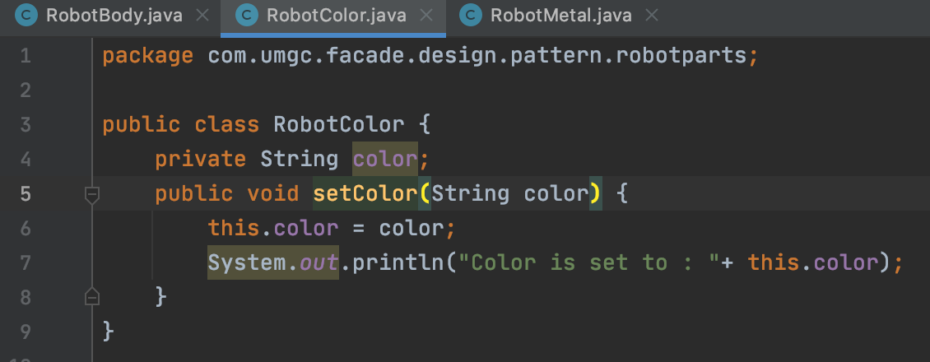
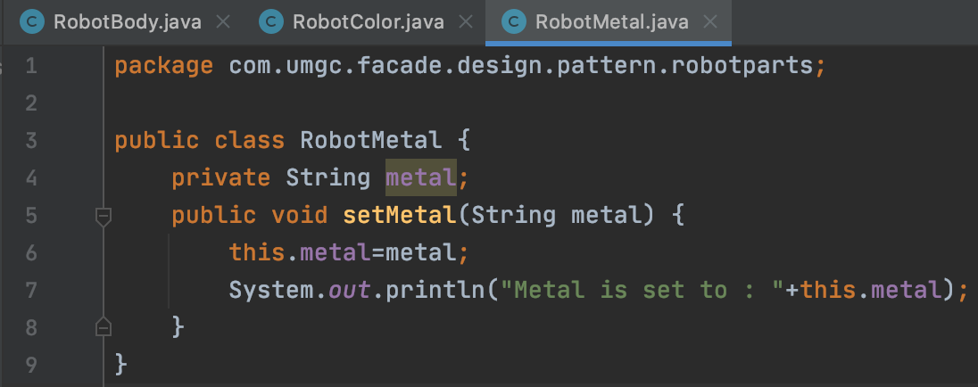
Example – RobotParts Classes
RobotParts package contains three classes.
RobotBody
RobotColor
RobotMetal

Slide 11
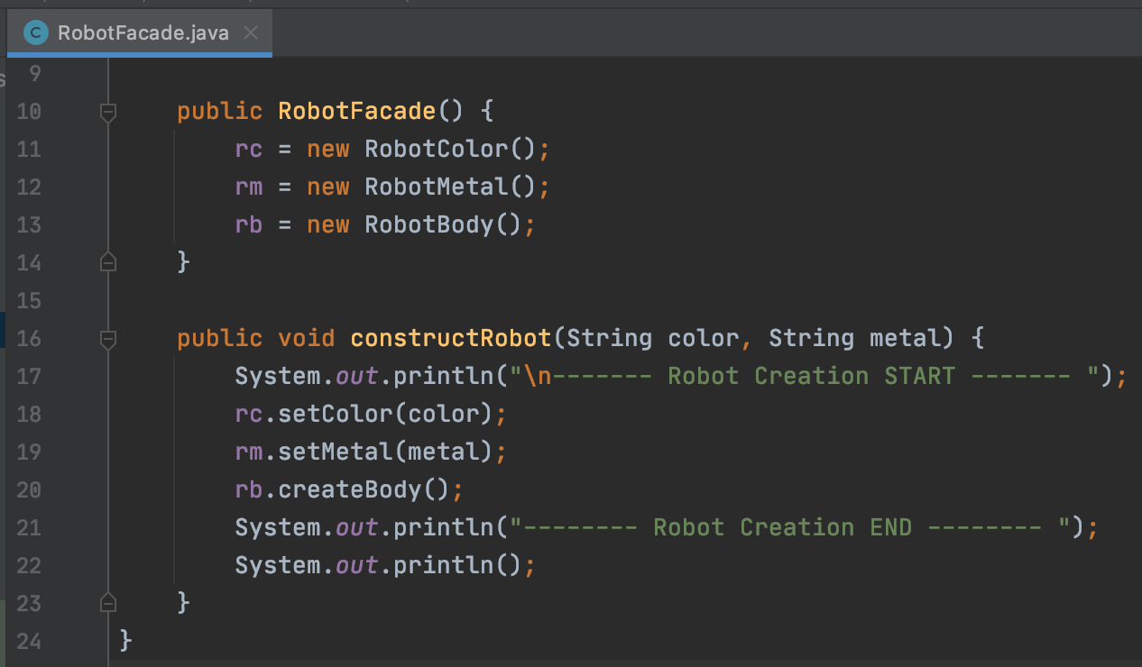
Example – RobotFacade class
RobotFacade class will have the implementation of the subclasses.
The constructRobot method calls the methods which are defined in the subclasses.

Slide 12
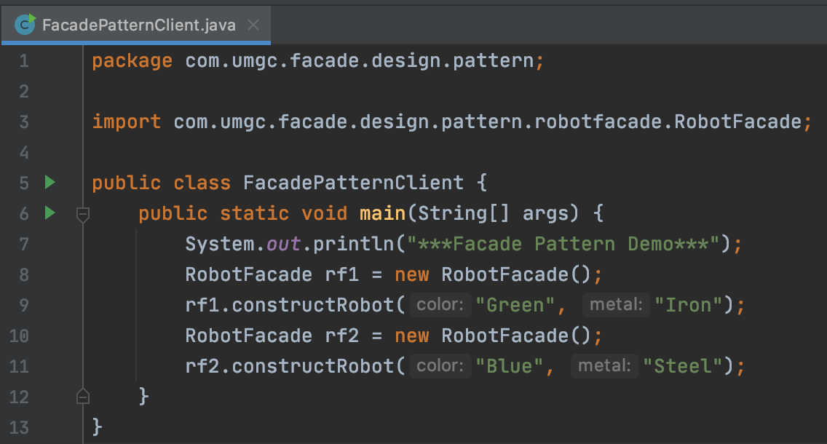
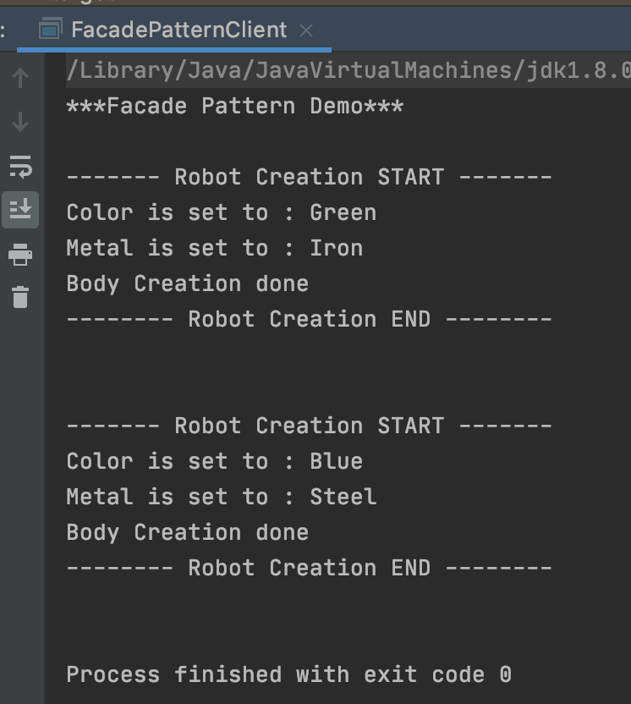
Example – Main Class / Client Class
FacadePatternClient Class
Execution Result

Slide 13
Pros & Cons
Pros :
Simplifies the execution of complicated classes
Simplifies the execution of custom classes with complex interfaces
Increases the reusability of a system or the library
Requires no intervention of the external systems or the client processes
Cons :
As it increases the reusability, it requires lot of effort and time to satisfy all sorts of the client system requirements
Also, if there is a change in the interface or the input arguments, then the related change need to take place in all the client applications.

Slide 14
Reference
No Author. (2013). Apex design patterns. Retrieved from https://developer.salesforce.com/wiki/apex_design_patterns#Facade
No Author. (n.d.). Façade design. Retrieved from https://en.wikipedia.org/wiki/Facade_pattern
Sarcar, Vaskaran. (2016). Java design patterns: a tour of 23 gang of four design patterns in java. Retrieved from http://library.books24x7.com.ezproxy.umgc.edu/toc.aspx?bookid=112048.

